Slide 1
Summerproject 2020 in Germany
Wilhelmshaven, summer 2019

Slide 2
cooperation
1987 - 2019
… very intensive with summerprograms and projects since 2012!
2
2
2

Slide 3
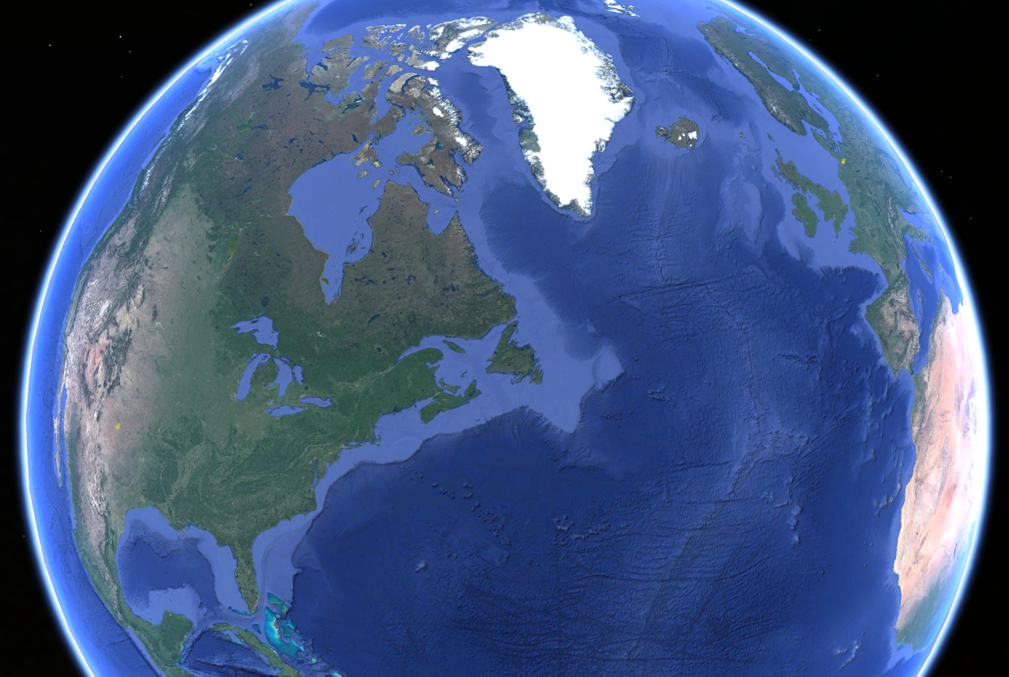
come to Germany
From USA - Texas- Lubbock to Europe - Germany - Wilhelmshaven

Slide 4
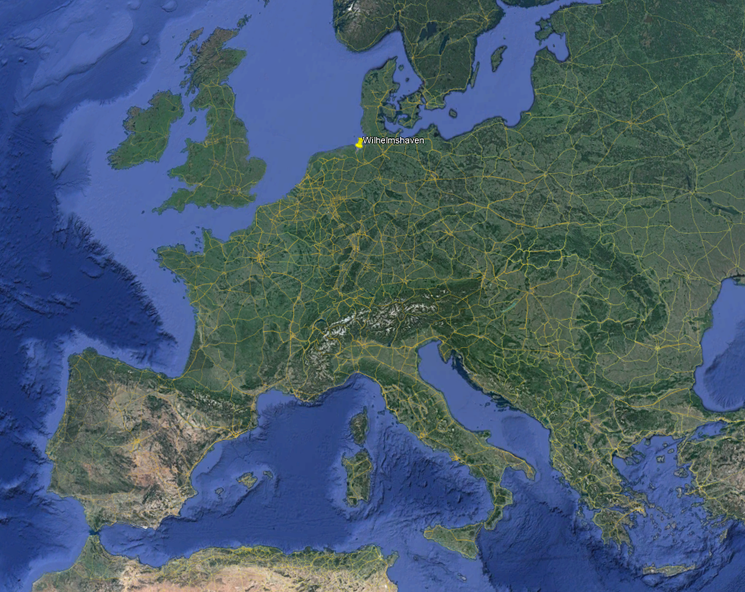
come to Germany
Europe - Germany - Wilhelmshaven

Slide 5
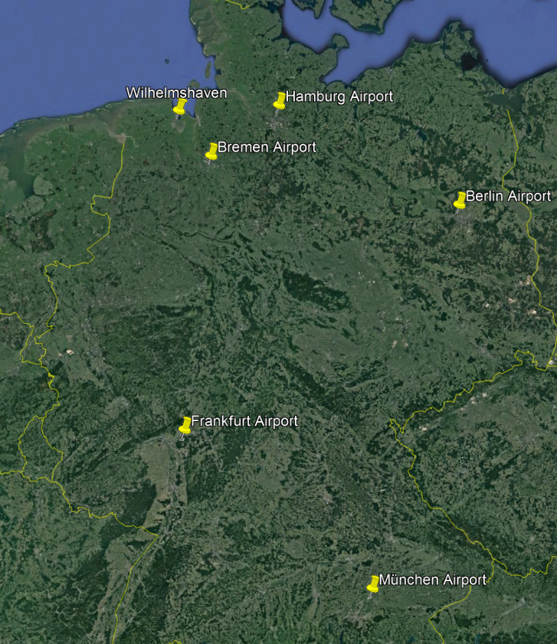
come to Germany
Germany - Wilhelmshaven

Slide 6
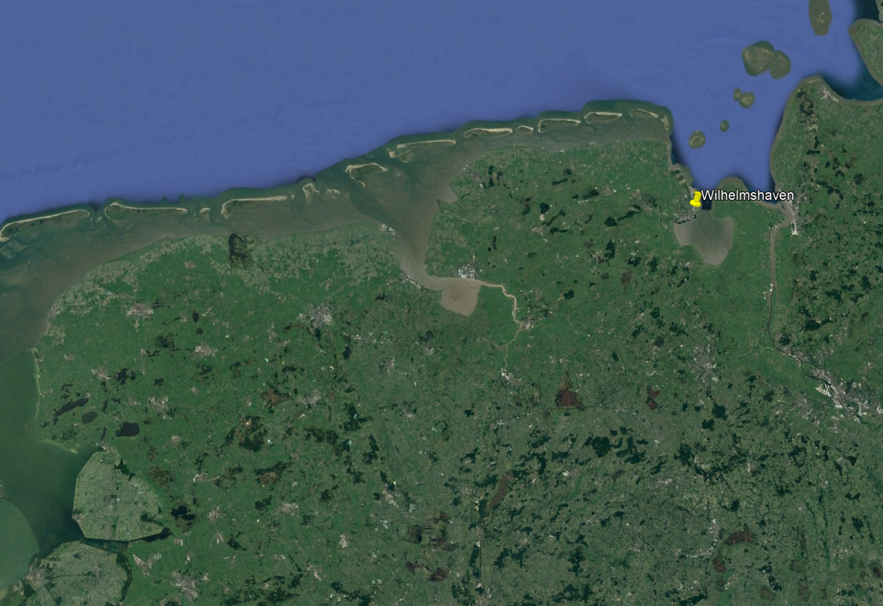
come to Germany
Wilhelmshaven

Slide 7
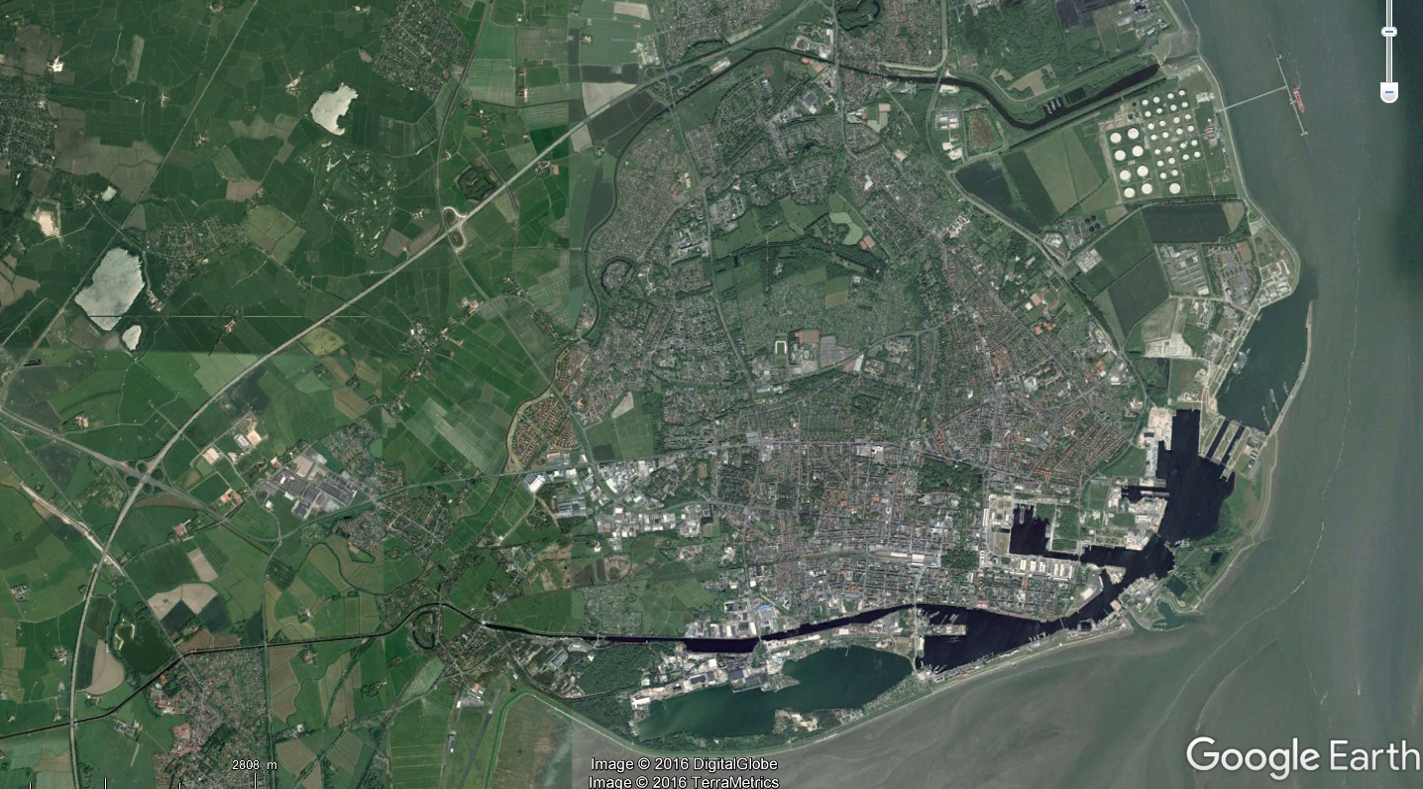
wilhelmshaven
Downtown – Hotel Campus
7
7
7

Slide 8
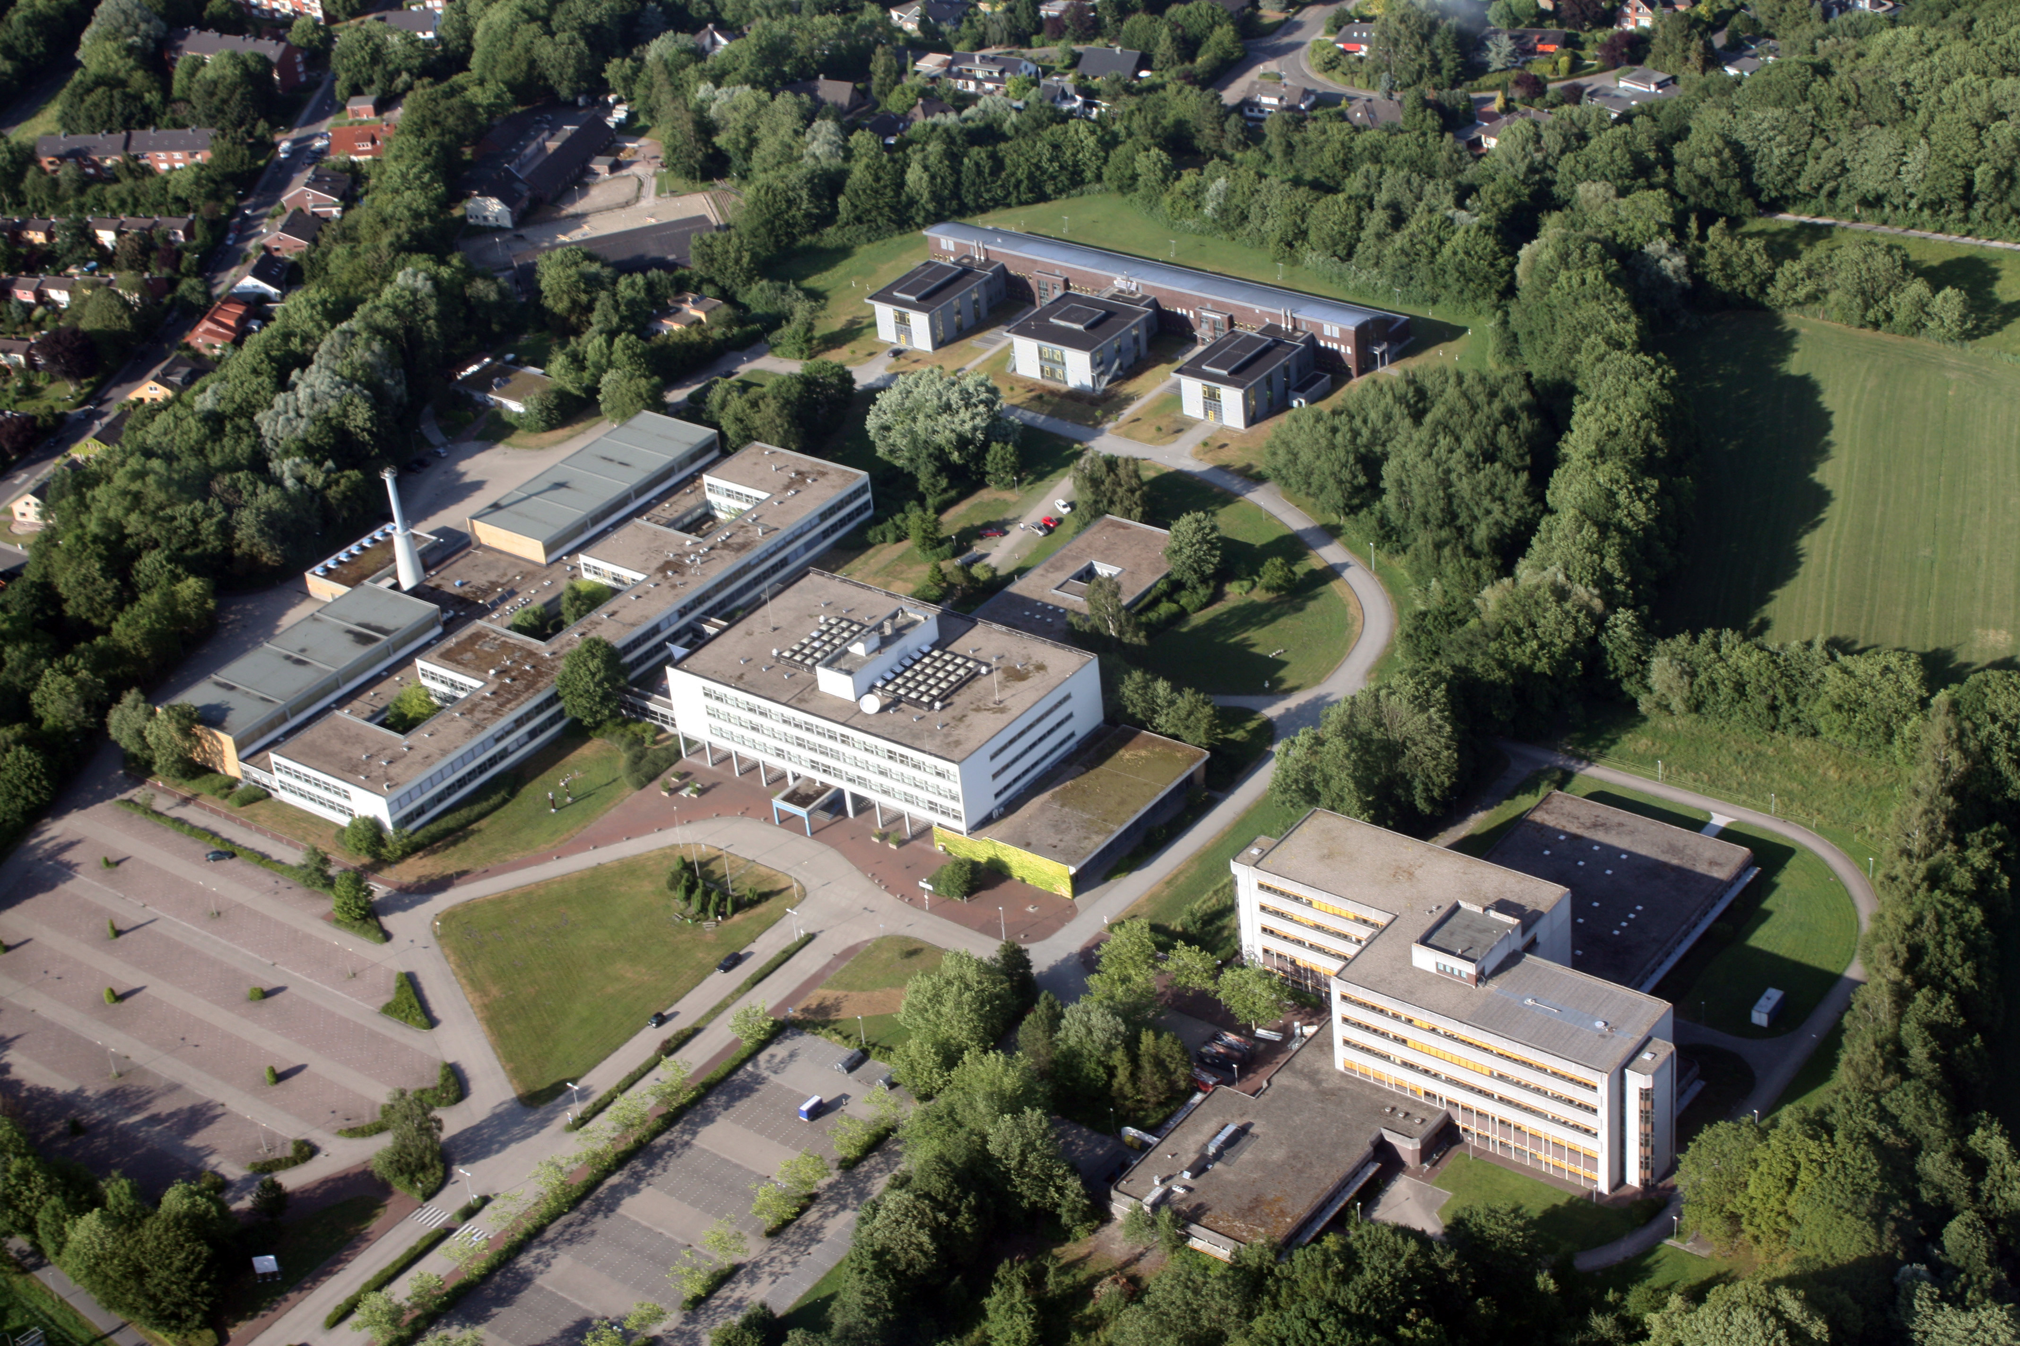
Campus Birdview
www.jade-hs.de
Foto: Lübben
8
8
8

Slide 9
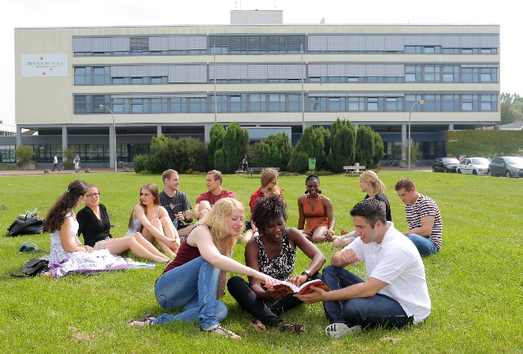
Campus mainbuilding

Slide 10
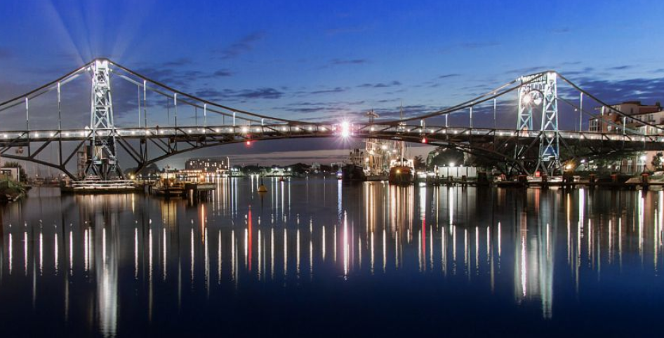
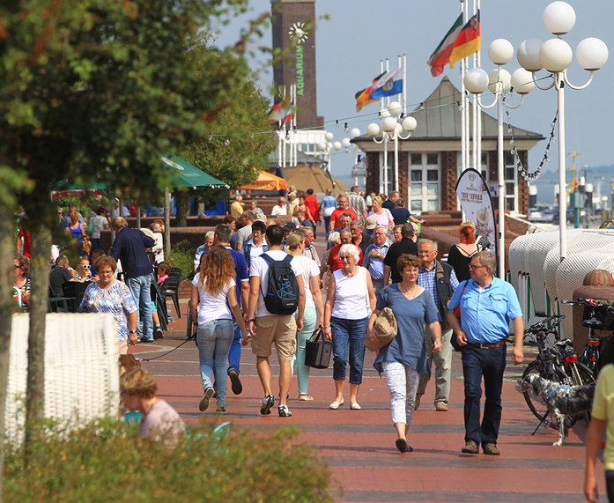
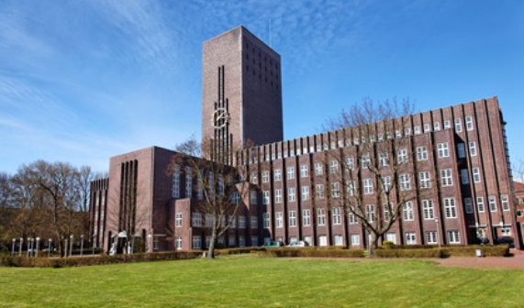
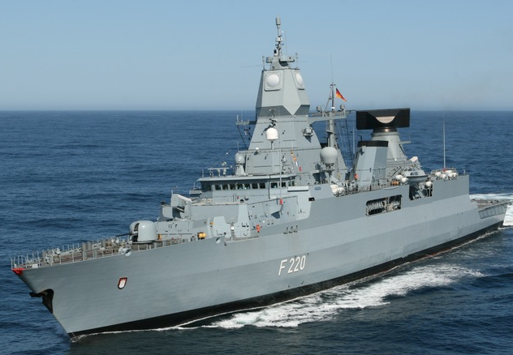
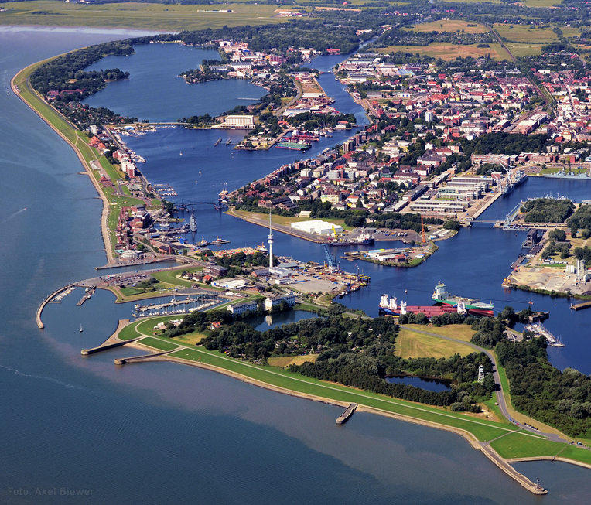
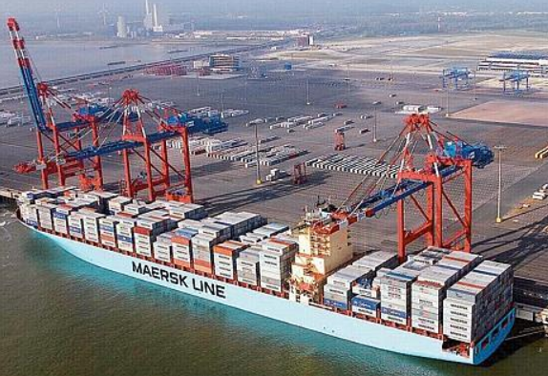
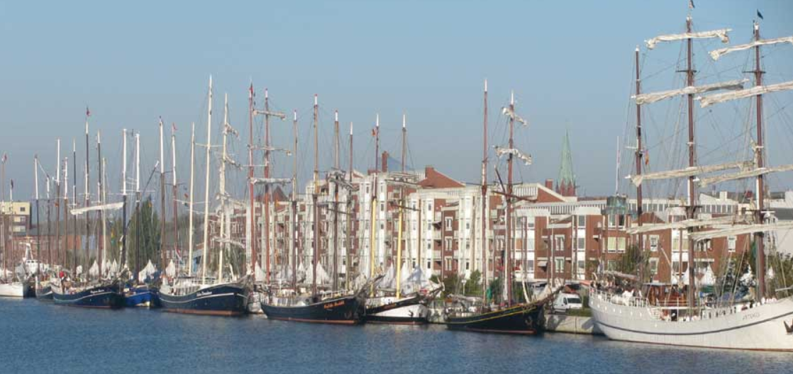
Wilhelmshaven
City at the North Sea
Largest continuous tidal flats in the world!
Lower Saxony Wadden Sea National Park
UNESCO World Heritage since 2009
10
10
10

Slide 11
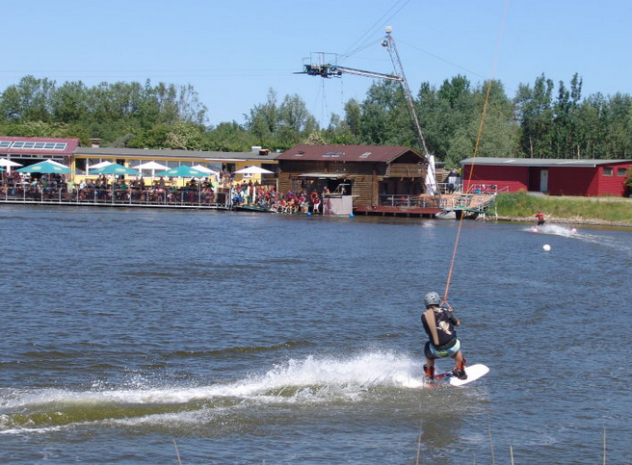
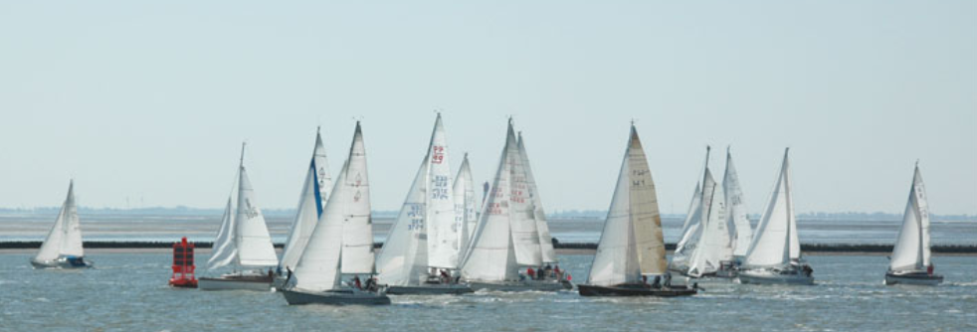
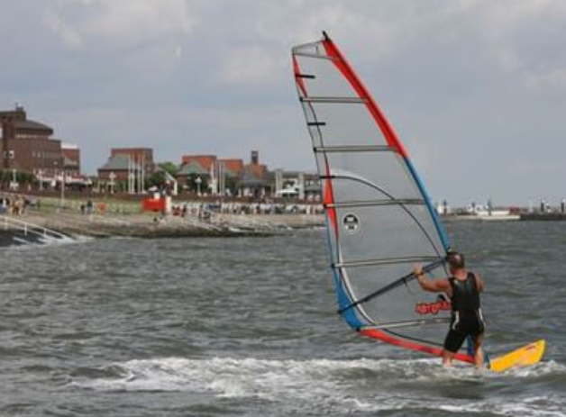
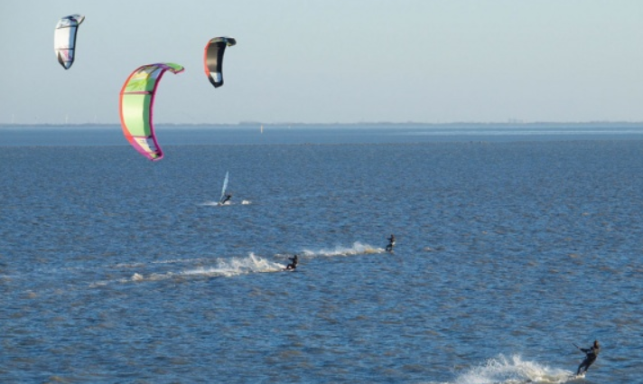
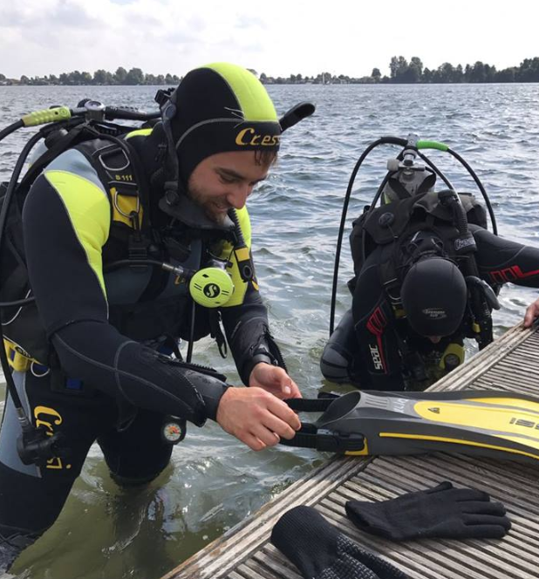
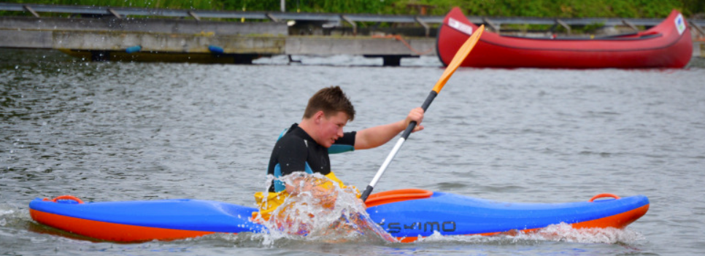
wilhelmshaven
Watersports
Watersports
11
11
11

Slide 12
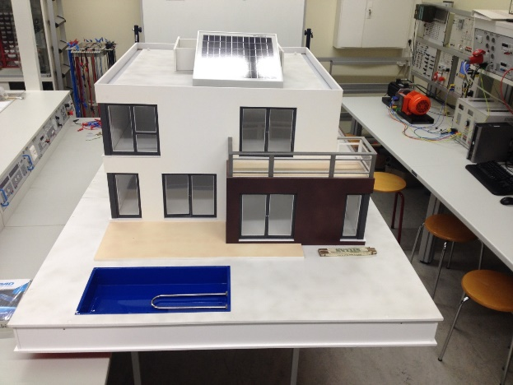
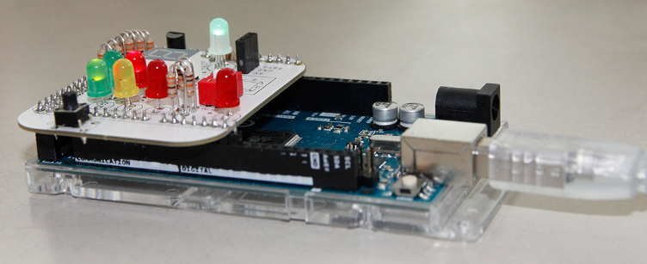
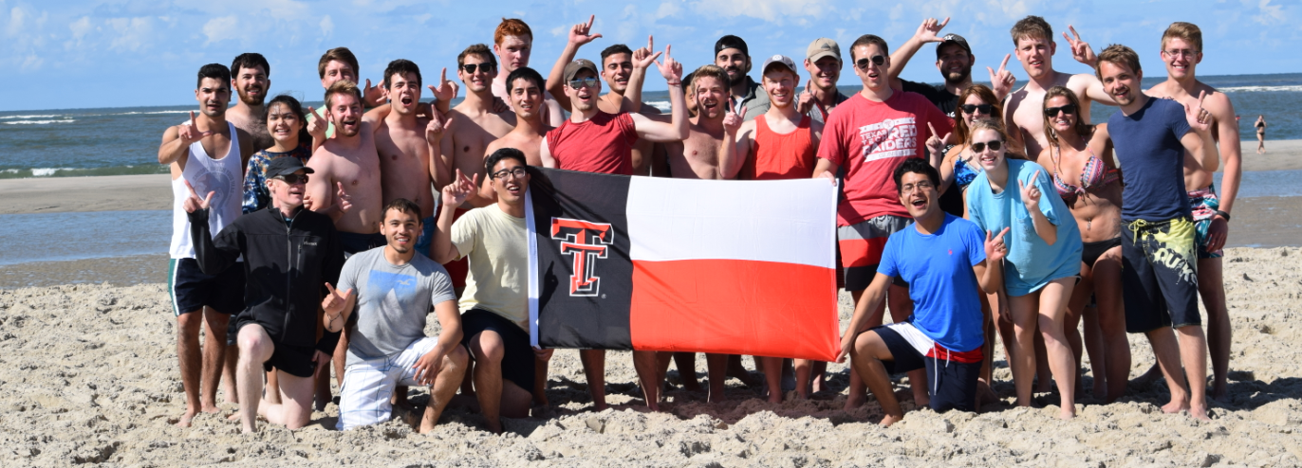
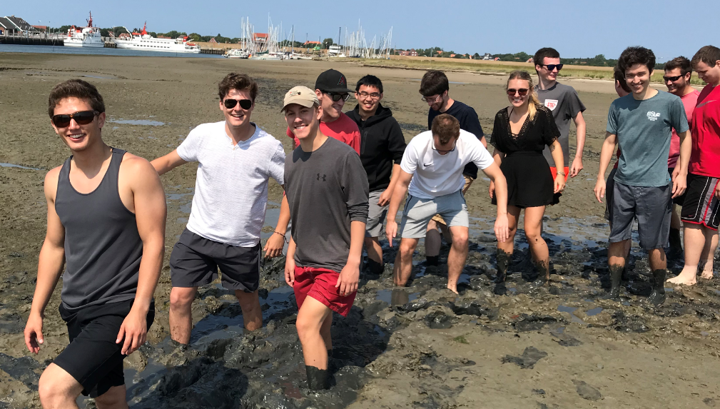
4th SummerproJECT 2020 in GERMANY
Cooperation since 1987 - Summerprojects since 2014
OFFER IN 2020: international smart home project
March – September
6 weeks in Germany at Jade - July 6th to August 16th 2020
2 x 3 cts (3 cts theoretical part, 3 cts practical part)
March/April 2020 Distance work | Grouping Distribution of sub-projects Literature research Web conferences
Summer 2020 TTU students travel to Jade July 6th to August 16th | First personal meetings Preparatory classes Detailed work packages Creating functions Resolving problems Documentation
August/September 2020 Distance work | Solving last problems System tests Documentation
September 2020 Jade students travel to TTU | Finals tests Final presentation at TTU
Largest continuous tidal flats in the world!
Lower Saxony Wadden Sea National Park
UNESCO World Heritage since 2009
Costs
$2.500 housing & breakfast
$ 750 program & activities fee
+ TTU fees
www.jade-hs.de/ttu
12
12
12

Slide 13
Engineering Research in Germany sponsored by Jade University of Applied Sciences
The project – overview:
International groups are built. 4-6 groups mixed with American and German students. Each group will work on a sub-project!
The students receive a complete physical system of a house model.
By using their skills they have to…
… create a concept
… complete the phys. system
with sensors and actors
… program the software and
… test the program
... control whole system via a wireless connection.
… the results of the sub-projects will be finally presented at TTU.
International groupwork.
13
13
13

Slide 14
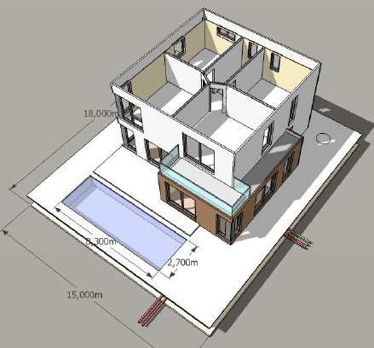
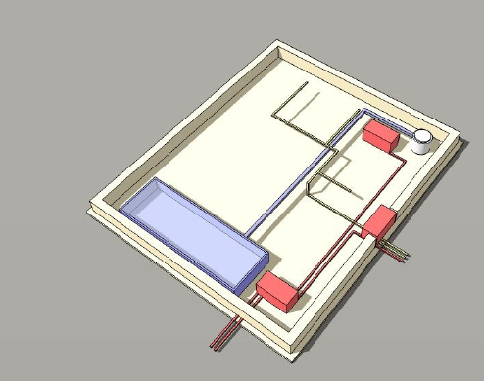
Model
Rooms have enought space for installing light and heating systems
Roof with possibilities for the installation of a photovoltaic cells
Foundation plate (place for control systems, electronics and storage)
Model home on a scale of 1:10
14
14
14

Slide 15
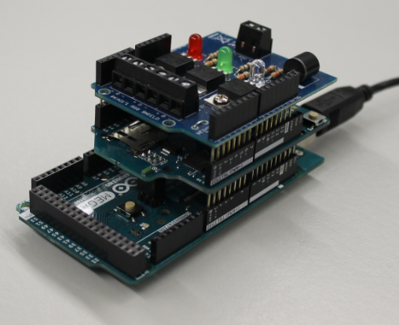
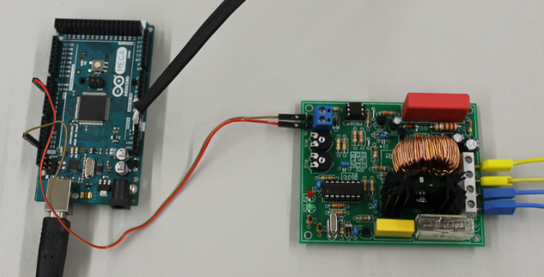
Model
Model 1:10
15
15
15

Slide 16
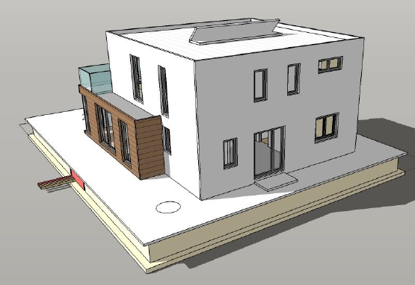
functions
Heating
Photovoltaics
Security system
Electricity
Programming
16
16
16

Slide 17
Sub-projects
Heating
heat supply in the house
heating the pool
Security System
cameras
alarm system
Energy Supply
photovoltaics
energ. storage
Programming
smartphone app
arduino
app
programming
energy management
programming
programming
event handling
Message
17
17
17

Slide 18
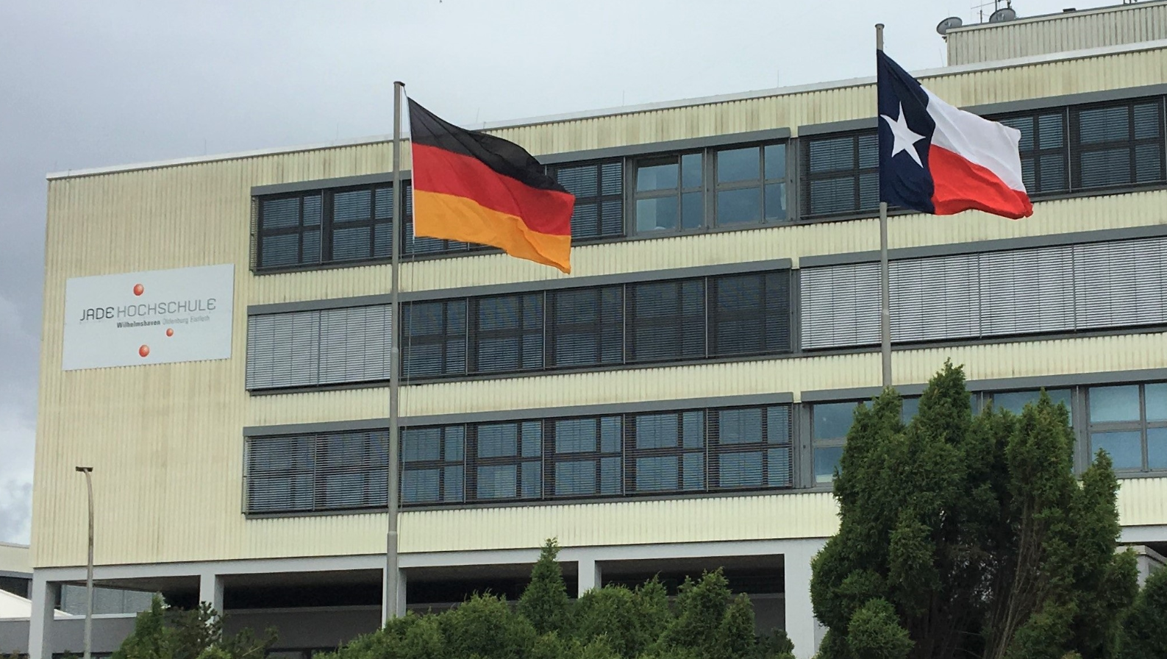
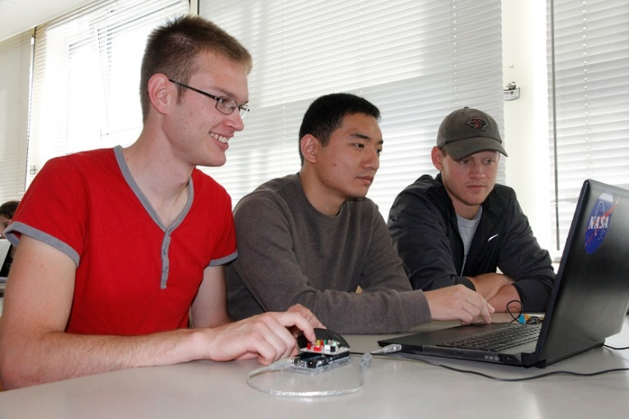
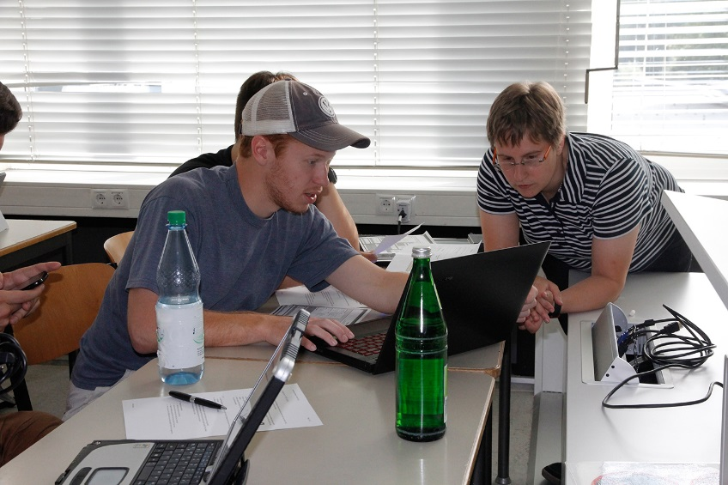
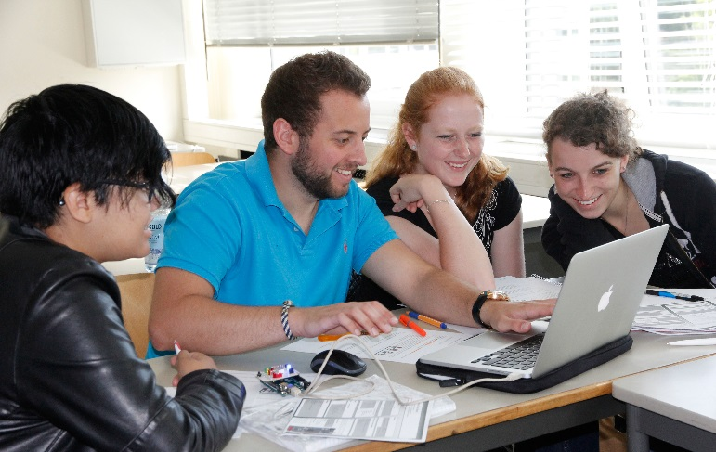
International experience
International experience during group-work in Wilhelmshaven
18
18
18

Slide 19
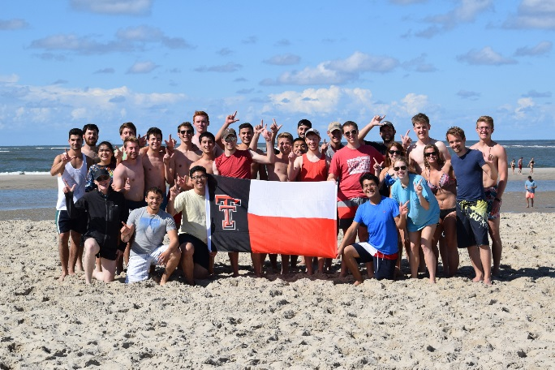
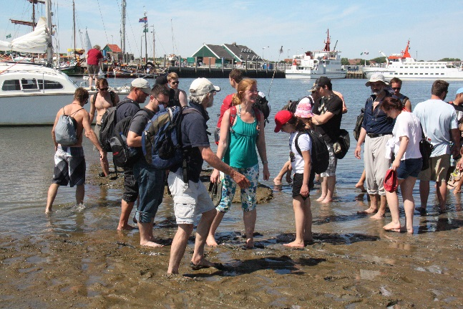
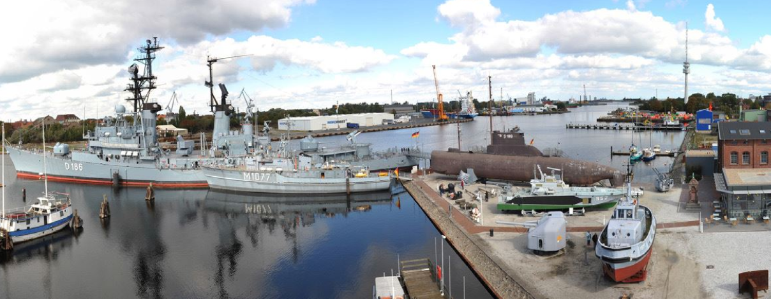
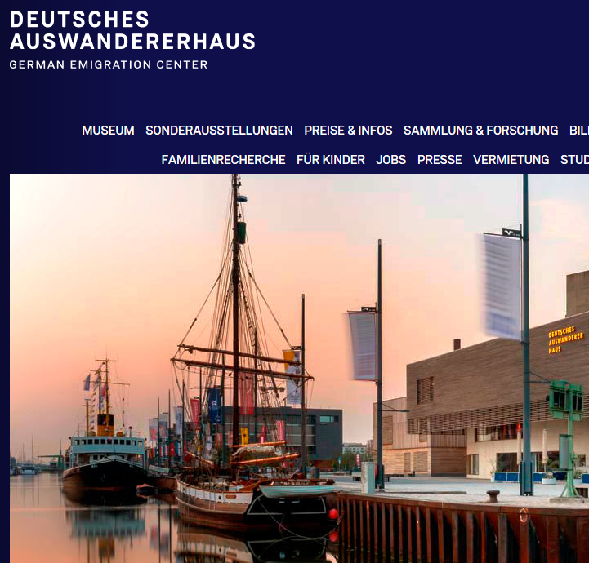
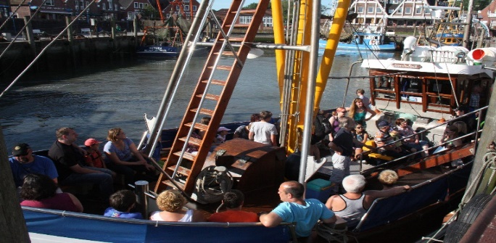
Additional program
Additional program
welcome lunch
guided town walk Wilhelmshaven
sightseeing bus tour Wilhelmshaven
welcome dinner
visit of the German Emigration Center Bremerhaven
volleyball with dinner
Spiekeroog island daytrip - World Heritage Wadden Sea
inner/outer harbor roundtrip
visit of the German Navy museum
final barbeque
Having fun.
19
19
19

Slide 20
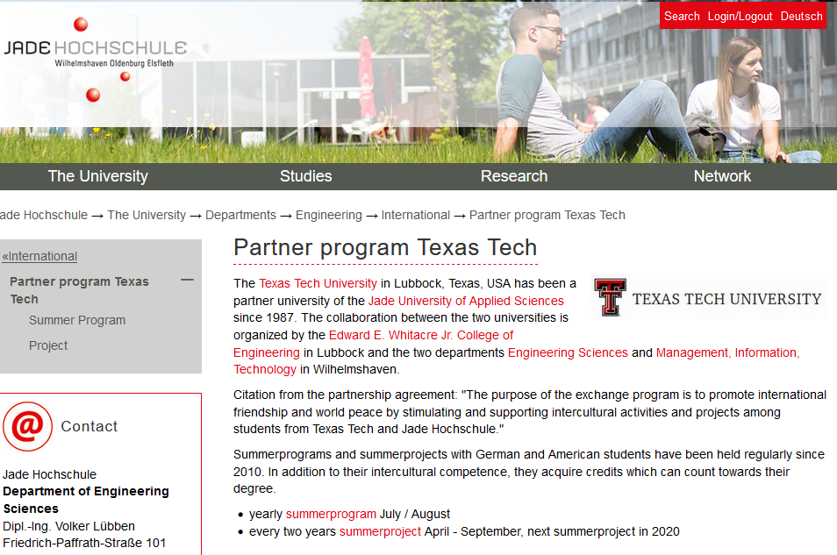
WEBSITE
Visit Germany Wilhelmshaven!
www.jade-hs.de/ttu
20
20
20

